Slide 1

Team DigiLab
Quality Monitoring:
How can we help the Hochbahn and other transport players to ensure that travel information for passengers is always displayed simultaneously on the individual apps and platforms?
How can potential sources of error be identified?

Slide 2

The Team
Nizam – AI Engineer
Sonia – UX Designer
Hossein – AI Engineer

Slide 3

Example: Traveling to the Hackathon
On the S-Bahn: Checking again the hvv App: bus is now AGAIN supposed to be on time
Running up to the busstation, but the bus is late as announced FIRST...
Where is Betahaus?
→ Checking Google Maps: 2 min from Altona Bahnhof Bahnstation to Altona Busstation
Checking again in Hvv app → 2 min bus delay, therefore one stop by S-Bahn to Altona Bahnhof
Going through to the end of the station (knowing where the stairs up to the bus station are)
Walking time = 10 min. to Altona station with a ‘fast walk‘, but heavy bag
Notes:
Always late
Checking where betahaus is, because there is no option to find the place in hvv app -> switching to googel maps
2 options: walking 10 mins to altona bahnhof or driving 1 station from königstr. Zu altona Trainstation
Google maps: only
- Not possible to search for a special place or location like Betahouse -> therefore switching from hvv to google maps -> looking up in google maps the next bus or train stop

Slide 4


Slide 5
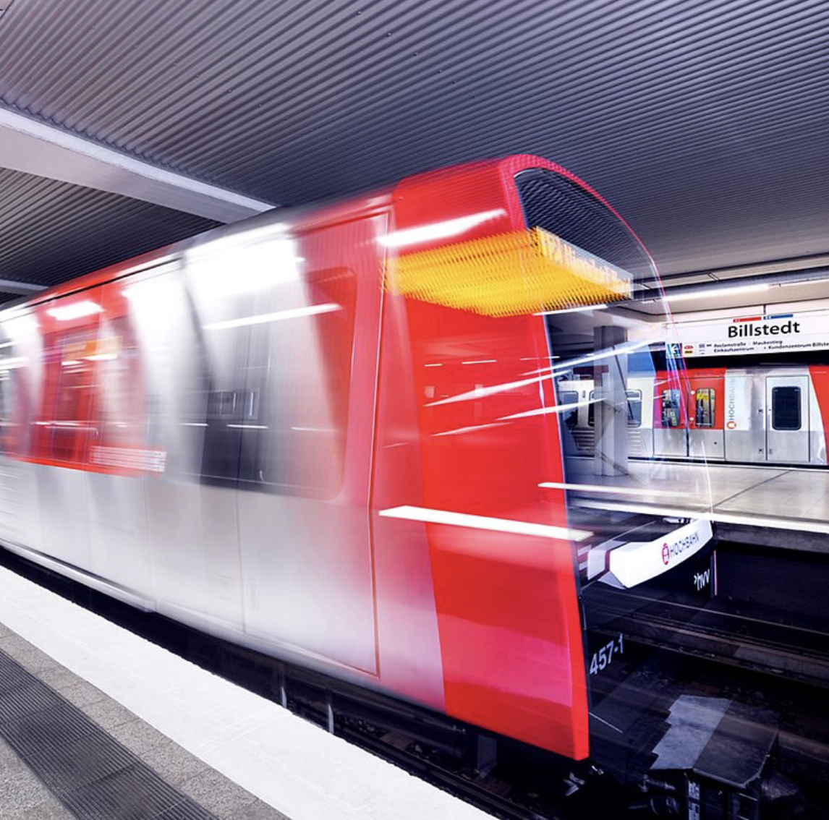
Problem:
Currently, different arrival and delay times of buses and trains are displayed in the individual apps (e.g. hvv, DB Navigator, Google Maps etc.) for one and the same connection.
Passengers are confused and/or annoyed because connections are missed
Public transportation is not perceived as reliable
Which app is correct about the delay time?
Notes:
Main Problem = the challenge, but after talking to DB, hearing about google maps talk -> deeper problem

Slide 6

Data Flow Overview – RIS Mindmap
Hvv App
Single source of truth
Geofox API
VBN
Displays Stations
RIS
RIS - API
DB – Backend Cached
DB Navigator App
Notes:
VBN = Data Hub

Slide 7
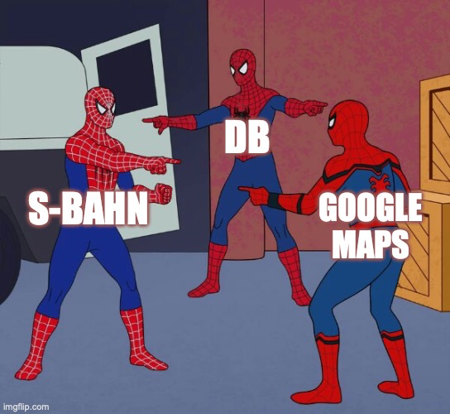

Slide 8
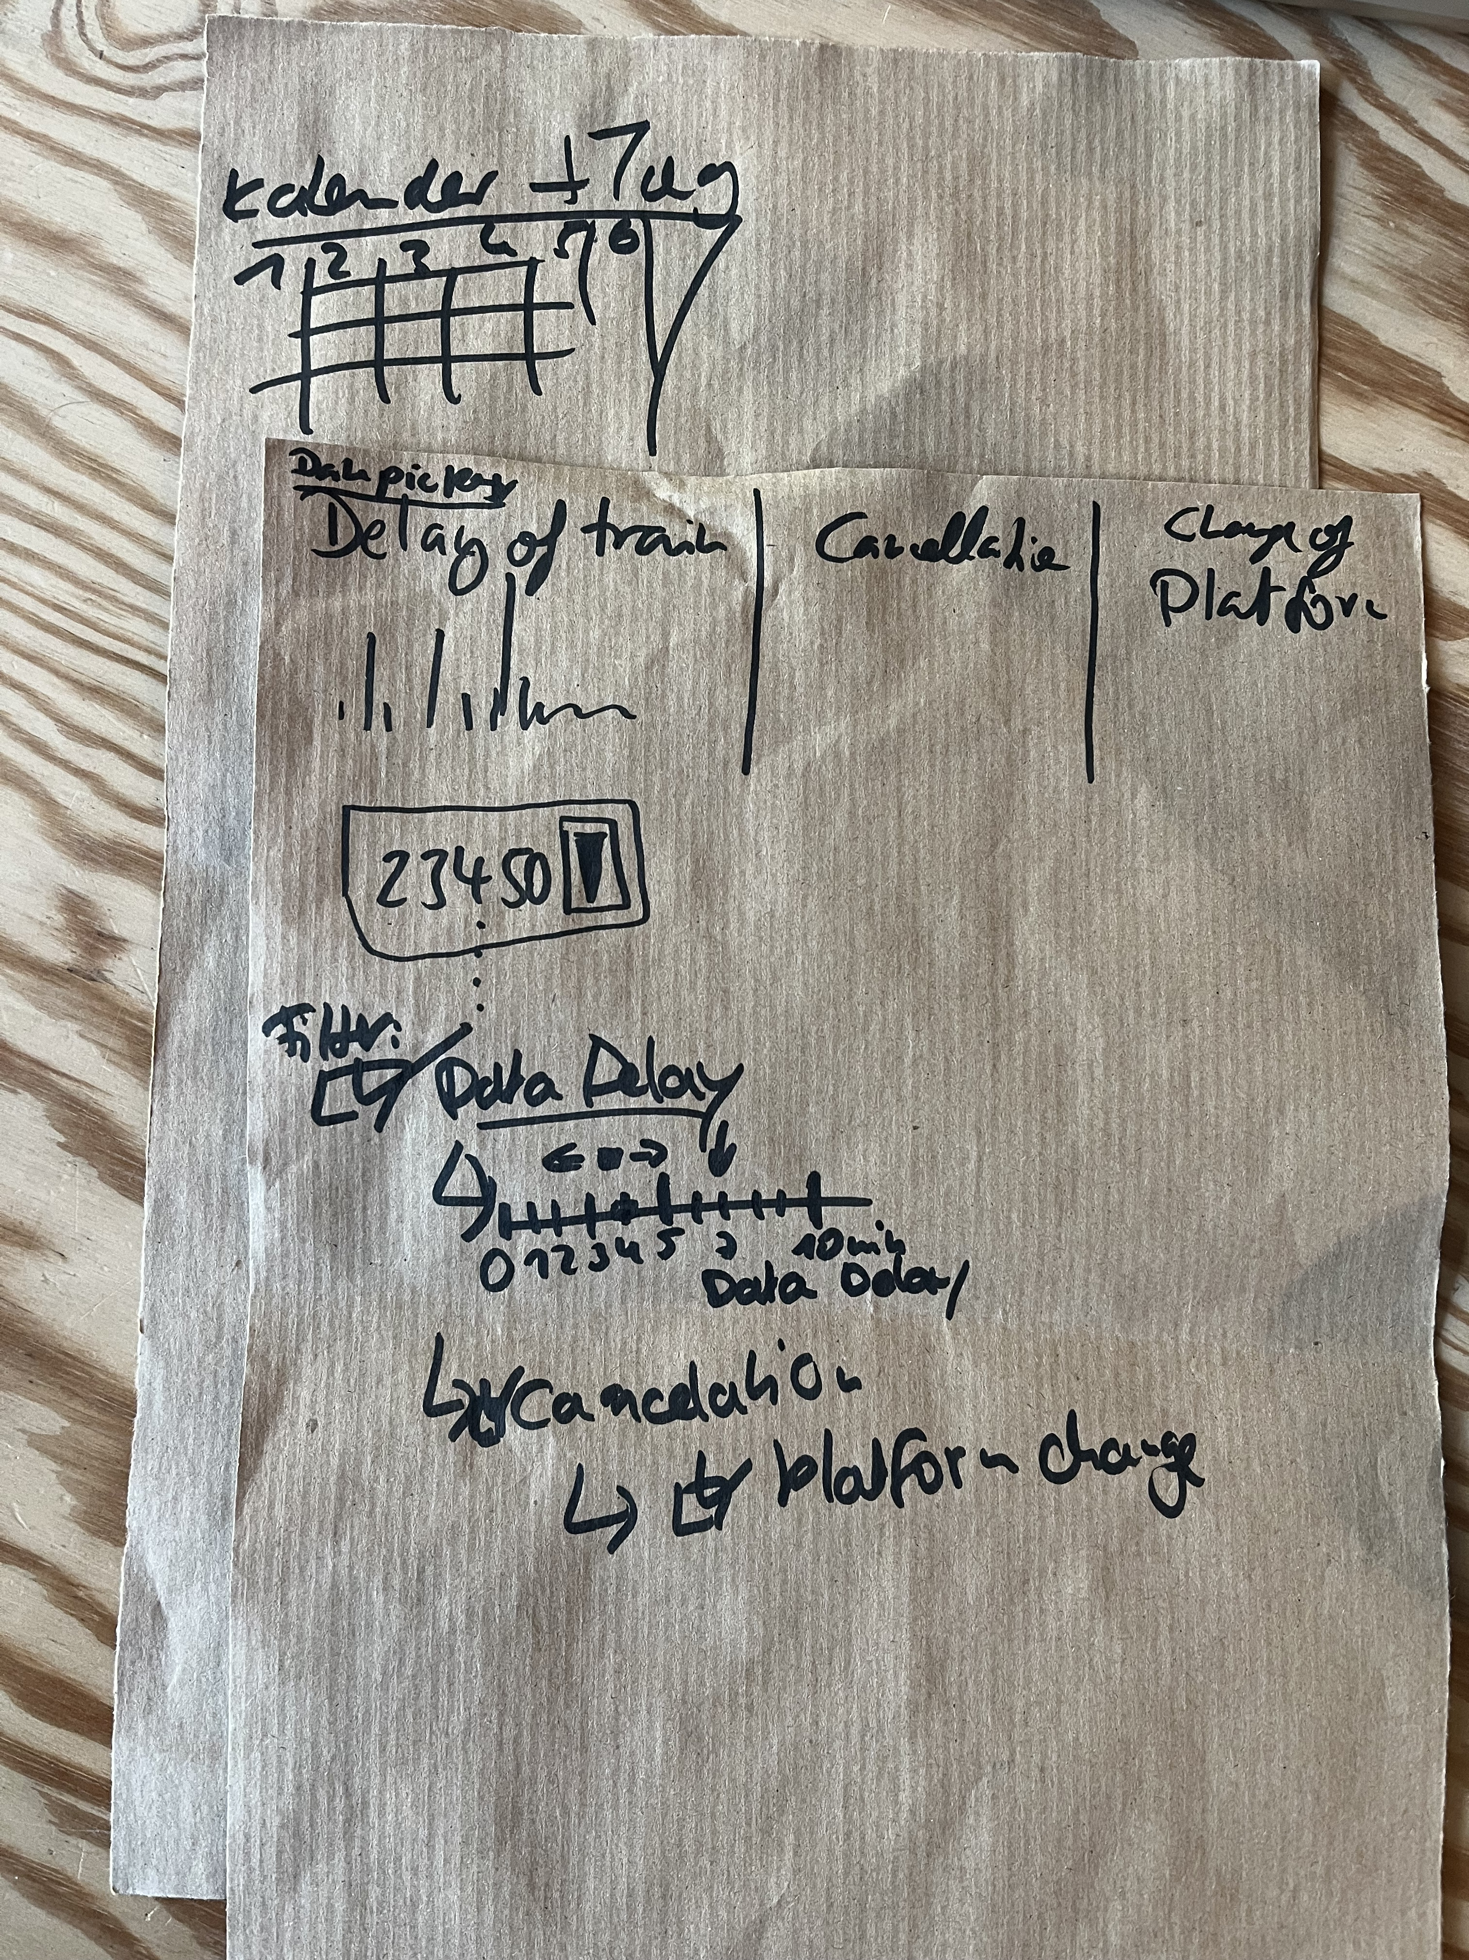
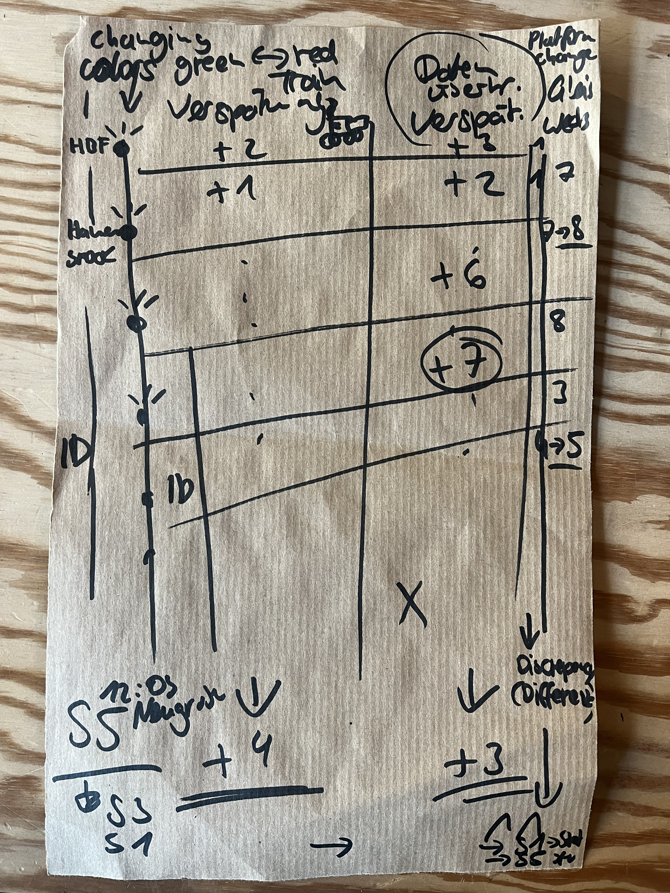
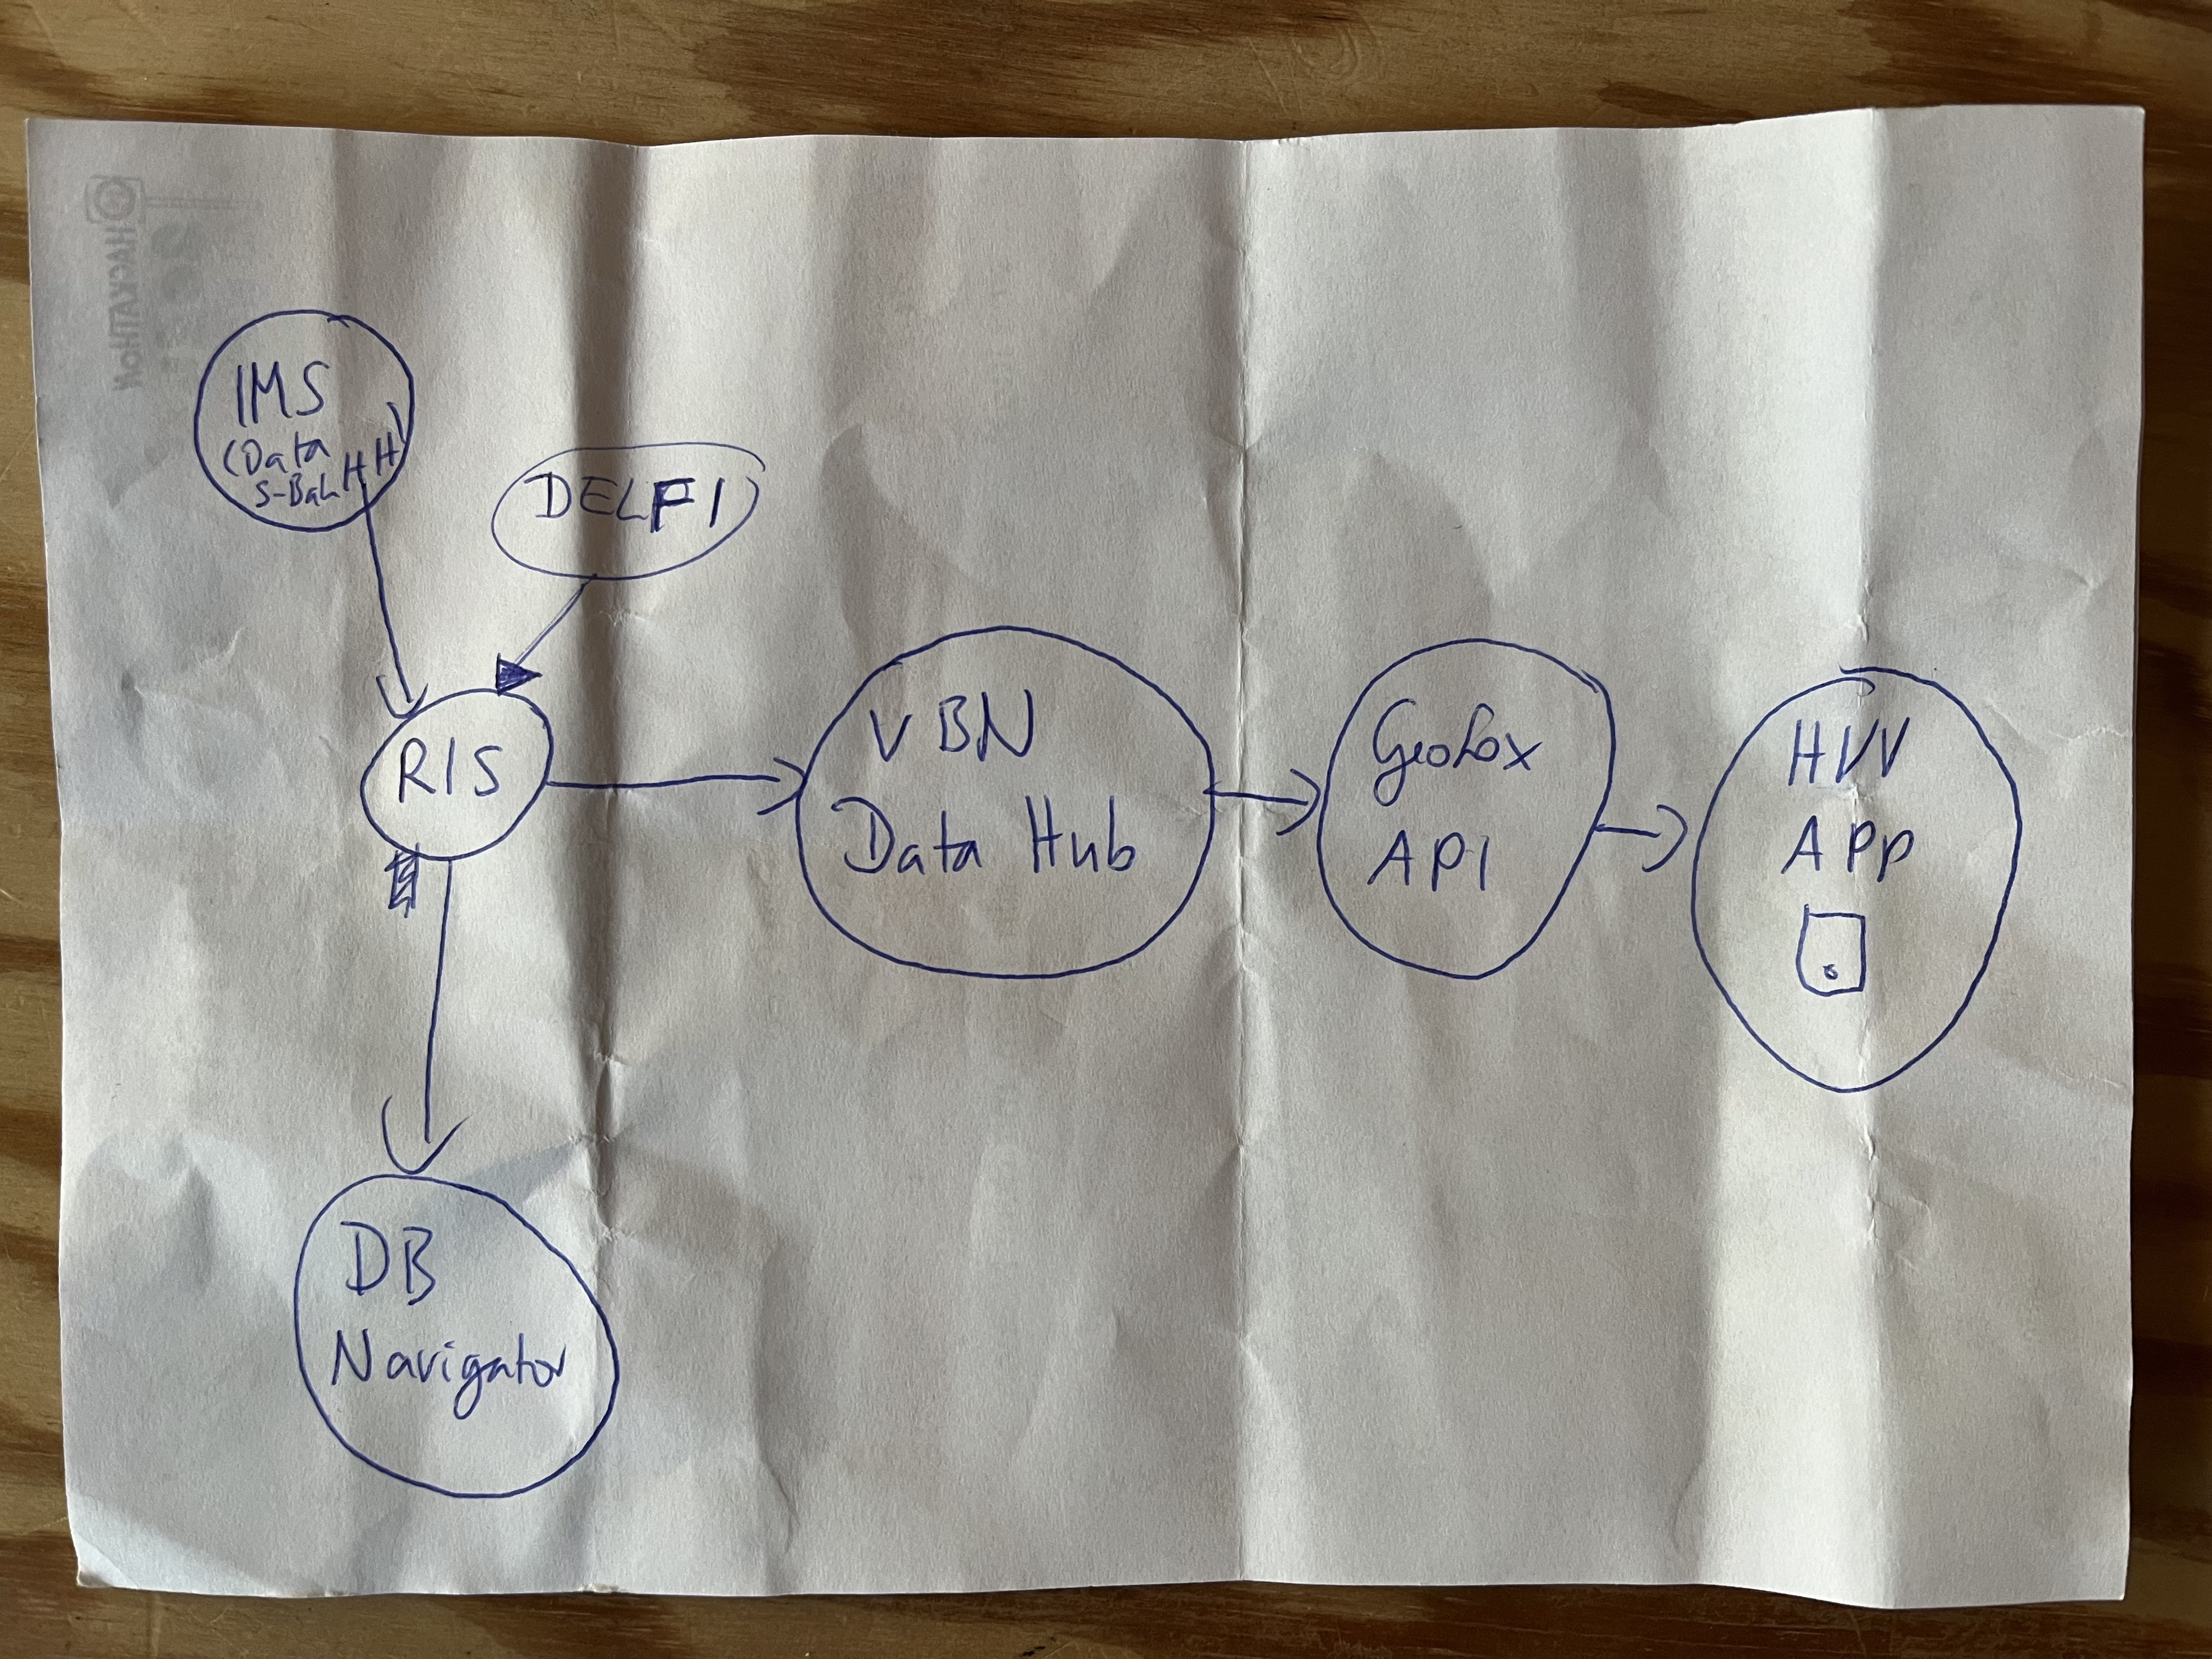
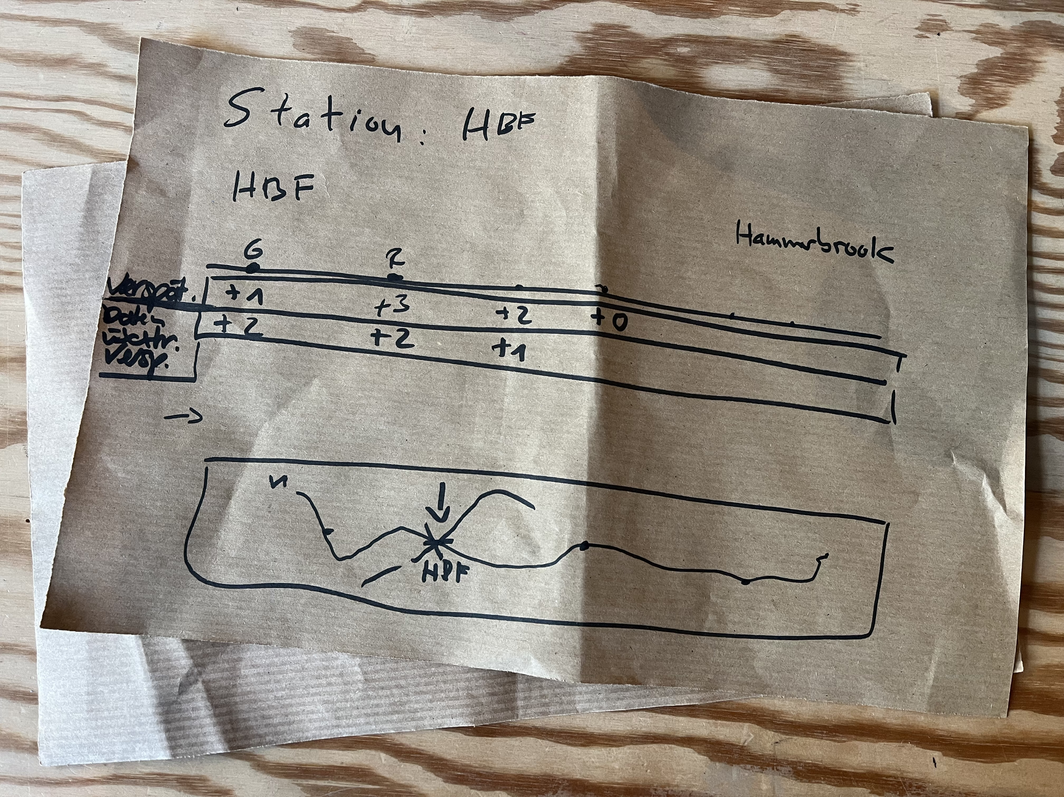
Journey

Slide 9
Our Journey & Workflow
User research with DB & S-Bahn:
→ What is especially useful for S-Bahn employees while using the dashboard?
→ Which functions would you like to see?
How should it be designed?
Example:
→ Vertical display, as already known from other portals at S-Bahn
→ Filter functions for better overview and statistical purposes

Slide 10
Demo
QICK DEMO

Slide 11
Prototype
DASHBOARD
PRESENTATION

Slide 12
Our Approach
How can our product help in public transport / ÖPNV?
→ The platform could help to identify the discrepancies between the delay times, which would in the end especially benefit the final user
Can rely on all apps speaking “the same language”, regardless of whether hvv, DB Navigator or Google Maps is used
Which data was used?
Open Data: Geofox & RIS API Data was used
Can the project be continued?
The basis for error and delay analysis via the platform has been created and can be further developed

Slide 13
Our Approach
Is it innovativ?
Not innovative, but desperately needed! As there is no standardized communication at the moment. Measured by DB, it is quote
“Super innovative if it could be automated to control the data”. :-)
What about accessibility?
Difficult in this project, as we created more or less a B2B platform/dashboard and do not have a user in the form of a passenger
Although color coding (red = delayed, green = on time) was still titled (in case of possible red-green weakness)
Dashboard could also be used with keyboard only (if person has less fine motor skills)

Slide 14

Potential features for future development
S-Bahn communication:
When one S-Bahn is blocking another S-Bahn - but the timetable shows the other S-bahn is on its way
The blockage is not reported to DB Navigation App, hvv App etc.
Integration of communication inbetween S-Bahn trains
Google Maps:
Integration of realtime S-Bahn data
Comparing Data:
Statistical comparison between train delays and data transfer delays

Slide 15

Potential features for future development
HVV App:
Implementing geocode of the landmarks/POIs in searchfunction
For e.g.: Currently it‘s not possible to search for ‘katze‘ or ‘betahaus‘ directly in the search filed
→ Instead you always need a address like Eifflerstr. 43 or the nearest bus/train-station-name
→ Switching to google maps app to get the info
Walking distance calculation:
Implementing and comparing the walking distance calculation between platforms/stations in different apps (hvv, DB Navigator etc.) and also extend the DB Navigator App (currently only for station to station walking)

Slide 16

Learnings
Asking questions, asking more questions and then ask even more questions...
Not assumimg that the stakeholders know exactly what they want and need to solve their problem
Public transport in Germany, especially in Hamburg, is special and complicated
not assumimg that the data provided will also work. :-)

Slide 17


Slide 18
